Slide 1
How to use <html>
For beginners.

Slide 2
Aim
I know how to code with <html>
I know how to make a course

Slide 3

Things for Html
And

Slide 4
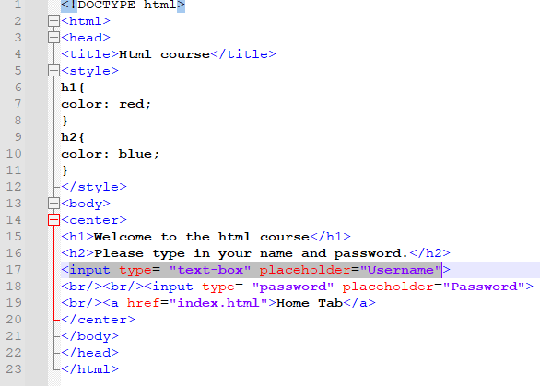
Code html
Always use <html> </html>

Slide 5
Table of html
html | head | style

Slide 6
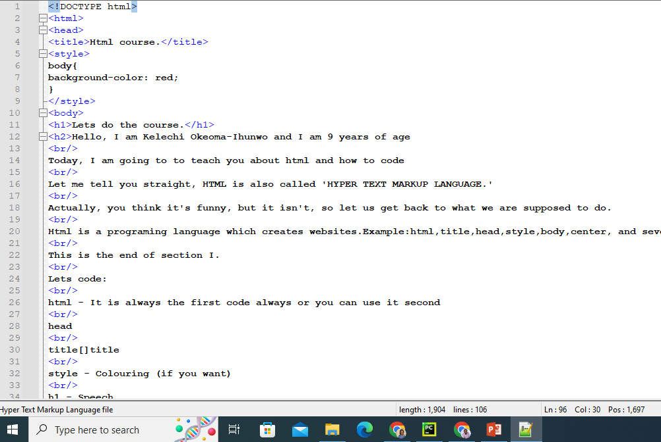
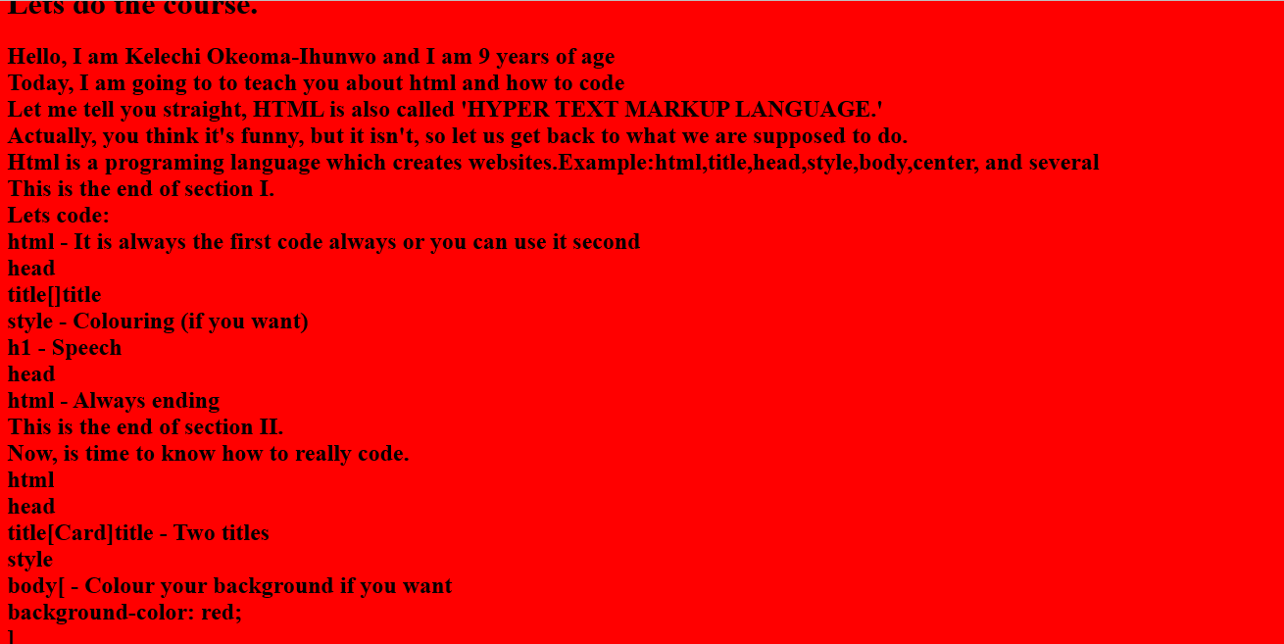
A task is to make a course
For 5 minutes

Slide 7
Vocabulary
Hyper
Html
Markup

